Slide 1
CS 4530: Fundamentals of Software Engineering Module 06: Concurrency Patterns in Typescript
Adeel Bhutta, Mitch Wand
Khoury College of Computer Sciences
© 2023,-2025 Released under the CC BY-SA license

Slide 2
Asynchronous Programming: we've been teaching it all wrong (again)
This slide is me explaining what's going on in this deck; it is not for distribution to students.
I finally that trying to explain async programming in terms of promises is like explaining typescript in terms of assembly language: it's just the *wrong level*
Among other things, it fails to emphasize that you can determine the points at which your execution can be interrupted is *statically determinable".
These slides *start* by explaining what the uninterruptible segments of your program are.
So we take "run to completion" as a fundamental concept (explaining that it's a misnomer), and go on from there.
See if you think this could work!!

Slide 3
Learning Goals for this Lesson
At the end of this lesson, you should be prepared to:
Explain the difference between JS run-to-completion semantics and interrupt-based semantics.
Given a simple program using async/await, work out the order in which the statements in the program will run.
Write simple programs that create and manage promises using async/await
Write simple programs to mask latency with concurrency by using non-blocking IO and Promise.all in TypeScript.
Notes:
<read slide>

Slide 4
Your app probably spends most of its time waiting
Consider: a 1Ghz CPU executes an instruction every 1 ns
Almost anything else takes approximately forever
Want to utilize this “wasted” time by doing something else
Processing data
Communicating with remote hosts
Timers that countdown while our app is running
Echoing user input
CPU 1
Main Memory
150,000ns (just to read 4KB)
SSD
thread0()
CPU 1 Cache
7ns
100ns
10,000,000ns (just to seek!)
Magnetic HD
~100,000,000ns
Earth to moon: ~16,000,000 inches
Remote Computer (Internet in between)
4
Notes:
First principles: why do we need concurrency?
Mostly I/O. We are spoiled today with huge amounts of RAM, but there are still occasions when you need to read or write something to/from disk, or to/from network.
This diagram shows roughly the overhead of different kinds of I/O, in nanoseconds. Cutting-edge hardware architectures and OS designs aim to reduce these delays, but the rough order of magnitudes still stand.
If we are “computing” things (running instructions on the CPU), on a 1Ghz CPU, that’s nice and round, so you get 1 instruction executed per nano-second. You could run 150k instructions in time to read 4KB from SSD, 10m instructions in time to get the read head on your spinning magnetic HD into place to read something, or 100m instructions in time to receive a packet over internet.
So, it is desirable to be able to keep doing things while we are waiting for I/O, and not stop the world. Another way to put this, is that we would like to mask this latency to do such slow operations with concurrency: do something else while these I/O operations are happening.

Slide 5
We achieve this goal using two techniques: 1. cooperative multiprocessing 2. non-blocking IO

Slide 6
Most OS's use pre-emptive multiprocessing
OS manages multiprocessing with multiple threads of execution
Processes may be interrupted at unpredictable times
Inter-process communication by shared memory
Data races abound
Really, really hard to get right: need critical sections, semaphores, monitors (all that stuff you learned about in op. sys.)
Notes:
In many programming languages, like Java or C, you can have asynchronous computation with threads.
You might be familiar with this programming model. As it turns out, the “inter-process communication by shared memory” part is extremely hard to get right, and almost impossible to prove correct
This is not how JS or TS does asynchronous computation.

Slide 7
Javascript/Typescript uses cooperative multiprocessing
In cooperative multiprocessing, only one process is executed at a time.
Each process pauses when it is convenient to allow other processes to make progress.
To make this practical (and avoid cheating!), we need a programming model that encourages this behavior
Notes:
In cooperative multiprocessing, each thread decides when it should yield to let other threads execute. For the purposes of this lecture, we will use the terms 'promise' and 'computation' interchangeably (MAYBE??)

Slide 8
async/await: a programming model for cooperative multiprocessing
In async/await, the program is organized into a set of "async functions".
An async function is like an ordinary function, except that it will pause at two well-defined points in its execution. We will show you those with an example.
When one program pauses, the runtime can choose to resume executing any process that is ready to run.

Slide 9
A typical async function
async function someFunction(i: number) {
const j = i + 1;
// ...
const k = await someOtherAsyncFunction(j);
// ...
const m = k + 100
return m;
}

Slide 10
An async function can only pause in two places
async function someFunction(i: number) {
const j = i + 1;
// ...
const k = await someOtherAsyncFunction(j);
// ...
const m = k + 100
return m;
}
It will never
pause in here
Or in here
Notes:
By disallowing interrupts everywhere but at the pause points, we avoid almost all of the data races you may have learned about in your operating systems class. Each grey box is a critical section, and your program consists of a set of critical sections. Each green box is uninterruptible!!

Slide 11
This is not Java!
src/data-races/dataRace2.ts
async function asyncPrintA() {
await waitRandom(1);
console.log('A');
}
async function asyncPrintBC() {
await waitRandom(2);
console.log('B');
console.log('C');
}
async function run() {
await Promise.all([asyncPrintA(), asyncPrintBC()])
}
run()
In Java, you could get an interrupt between the print B and the print C.
So the output would be BAC.
In TS/JS, the print B and print C are in the same critical section, so BAC is impossible!
Notes:
In an interrupt-based model, it is possible that statement the print A runs *between* the print B and the print C. Not for us!
(Don't worry about the details of the run() procedure-- we'll explain that soon).

Slide 12

What happens at those pause points?
async function someFunction(i: number) {
const j = i + 1;
// ...
const k = await someOtherAsyncFunction(j);
// ...
const m = k + 100
return m;
}
Pause points
Notes:
An async function yields or pauses in exactly two places in its code. What happens at those places?
When someFunction yields at the first location, it informs the runtime that someOtherAsyncFunction(j) is ready to run, and that someFunction will be ready to resume its execution only when someOtherAsyncFunction(j) returns a value. The runtime can then switch to any process that is ready. That might be the call to someOtherAsync function, but it might be something else.
When someFunction yields at the second location, it informs the runtime that it is ready to return to its caller, and it gives the runtime permission to switch to any process that is ready. It might be the caller of someFunction, or it might be something else.

Slide 13
Terminology: promises and run-to-completion
Each uninterruptible unit of work is called a "promise"
The pattern we've just talked about is called "run-to-completion" semantics, because a pause point corresponds exactly to the end of one of these units of work
You can do lots of different things with promises.
Let's look some typical patterns.
Notes:
run to completion means that if you start executing a task (or async) function then it must complete unless it awaits on something

Slide 14
Example:
src/XXXXX/oneRequest.ts
// fakeRequest(n) is an async that waits for 1 second and then
// resolves with the number n+10
import { fakeRequest } from "./fakeRequest";
import { timeIt } from "./timeIt";
async function main() {
console.log('main started');
const request = 32
const res = await fakeRequest(request);
console.log(`fakeRequest(${request}) returned: ${res}`);
console.log('main done');
}
timeIt(main)
$ npx ts-node oneRequest.ts
main started
fakeRequest received request: 32
time passes....
fakeRequest(32) returned: 42
main done
1015.98 msec
Notes:
Review the code. main() waits for the request to return, and then continues.

Slide 15
Use Promise.all to execute several requests concurrently
async function main() {
console.log('starting main');
const promises = [fakeRequest(1),
fakeRequest(2),
fakeRequest(3)];
const results = await Promise.all(promises);
console.log('results:', results);
console.log('main done');
}
timeIt(main)
$ npx ts-node threeRequestsConcurrently.ts
starting main
fakeRequest received request: 1
time passes....
fakeRequest received request: 2
time passes....
fakeRequest received request: 3
time passes....
results: [ 11, 12, 13 ]
main done
1018.81 msec
Notes:
Here's an example of starting several requests concurrently. Remember that each call to fakeRequest() takes 1 second (1000 msecs), and here we completed 3 of them in just over 1 second. So something in these three requests must have run concurrently.
In this case, it was the timers in the three fakeRequests that ran concurrently. Had this been a real request (say an http request or a database fetch), those requests would be "in-flight" concurrently. We'll see this in more detail in a few minutes.
Note that if any of the promises fail, then the Promise.all fails (we'll talk about promise failure a little later).

Slide 16
If you add awaits, the requests will be processed sequentially
$ npx ts-node threeRequestsSequentially.ts
starting main
fakeRequest received request: 1
time passes....
fakeRequest(1) returned: 11
fakeRequest received request: 2
time passes....
fakeRequest(2) returned: 12
fakeRequest received request: 3
time passes....
fakeRequest(3) returned: 13
main done
3024.03 msec
async function main() {
console.log('starting main');
const res1 = await fakeRequest(1);
console.log(`fakeRequest(1) returned: ${res1}`);
const res2 = await fakeRequest(2);
console.log(`fakeRequest(2) returned: ${res2}`);
const res3 = await fakeRequest(2);
console.log(`fakeRequest(2) returned: ${res3}`);
console.log('main done');
}
timeIt(main)
src/XXXXX/threeRequestsSequentially.ts
Notes:
By contrast, here we wait for each request to return before issuing the next one. Each fakeRequest takes 1000 msec, and we can see that the whole thing took 3000 msecs-- no concurrency here!

Slide 17
…but it would be much slower
$ npx ts-node timeComparison.ts
After 100 runs of length 10
makeRequestsConcurrently: min = 23 avg = 34 max = 190 milliseconds
makeRequestsSerially : min = 210 avg = 237 max = 812 milliseconds
Need to redo with this semester's examples
Notes:
We should leverage concurrency whenever possible.
(Time is average of 100 runs on Prof. Wand’s Lenovo X1)

Slide 18
Why is that? Visualizing Promise.all
“Don’t make another request until you got the last response back”
Sequential (await)
237 msec
send
wait
receive
send
wait
receive
send
wait
receive
“Make all of the requests now, then wait for all of the responses”
Concurrent (Promise.all)
34 msec
send
wait
receive
send
wait
receive
send
wait
receive
Notes:
In both cases, there is at most one active promise (in green) at any time! But the concurrent version "masks latency with concurrency", as we said way back on slide 1.

Slide 19
Requests can also be chained (if they are serial)
async function main() {
console.log('main started');
const request1 = 32
const res1 = await fakeRequest(request1);
console.log(`fakeRequest(${request1}) returned: ${res1}`);
const res2 = await fakeRequest(res1);
console.log(`fakeRequest(${res1})returned: ${res2}`);
const res3 = await fakeRequest(res2);
console.log(`fakeRequest(${res2})returned: ${res3}`);
console.log([request1, res1, res2, res3]);
console.log('main done');
}
$ npx ts-node threeRequestsChained.ts
main started
fakeRequest received request: 32
time passes....
fakeRequest(32) returned: 42
fakeRequest received request: 42
time passes....
fakeRequest(42)returned: 52
fakeRequest received request: 52
time passes....
fakeRequest(52)returned: 62
[ 32, 42, 52, 62 ]
main done
3080.99 msec
Notes:
In the examples so far, the arguments to the requests were independent of each other. But there's no reason they have to be independent (except for Promise.all). You can make them any way you need to.

Slide 20
Recover from errors with try/catch
// a request that may fail
async function maybeFailingRequest(req: number): Promise<number> {
const res = await fakeRequest(req);
if (res < 0) {
throw new Error(`Request ${req} failed because response ${res} < 0`);
} else {
return res;
}
}
Notes:
asyncs play nicely with try/catch. Here we've tweaked fakeRequest so that it will sometimes throw an error, and here's a wrapper that recovers from those errors (by returning 0).

Slide 21
try/catch, continued
async function main() {
console.log('main started');
const req1 = -32
let res: number;
try {
res = await maybeFailingRequest(req1);
console.log(`fakeRequest(${req1}) returned: ${res}`);
} catch (err) {
console.error(`Error occurred for request ${req1}`);
res = 0
}
console.log('main done with res =', res);
}
timeIt(main);
$ npx ts-node tryCatchExample.ts
main started
fakeRequest received request: -32
time passes....
Error occurred for request -32
main done with res = 0
1007.52 msec

Slide 22
Pattern for testing an async function
test('fakeRequest should return its argument + 10', async () => {
expect.assertions(1)
await expect(fakeRequest(33)).resolves.toEqual(43)
})
// this will succeed, because it does not await the promise
test('bogus test', async () => {
// expect.assertions(1)
expect(fakeRequest(33)).resolves.toEqual(99)
})
src/XXX/jest-example.test.ts
Notes:
Let's change the subject. How do you test an async function? To test an async function, make the second argument to ‘test’ an async function. This will make ‘expect’ itself an async function, so you will need to ‘await’ its result. Calling expect.assertions checks to make sure that your test properly awaited the the result of the request.
This example is easy, since we are only sending some data to a public web site. If we wanted to do something that might have a global effect (e.g. a transcript database), we'd have to do some mocking. Alas, that is too much for this lecture ☺.
Here, echo is an async function, so it returns a promise, which should eventually return a string (here “33”) to the async function that called it (here, the expect). So here we are saying that we expect echo(33) to return a promise that will eventually resolve to “33”.
Note the await on the next to last line. If you leave that out, the async function in the test will succeed immediately, without waiting for the expect to run. The expect.assertions (in blue) tells Jest that the test should run exactly 1 test, so that will make the test fail if you leave out the await.

Slide 23
AntiPattern 1: unawaited promise
src/XXXXX/oneRequestNoAwait.ts
// fakeRequest(n) is an async that waits for 1 second and then
// resolves with the number n+10
import { fakeRequest } from "./fakeRequest";
import { timeIt } from "./timeIt";
async function main() {
console.log('main started');
const request = 32
const res = fakeRequest(request);
console.log(`fakeRequest(${request}) returned: ${res}`);
console.log('main done');
}
timeIt(main)
$ npx ts-node oneRequestNoAwait.ts
main started
fakeRequest(32) returned: [object Promise]
main done
2.64 msec
fakeRequest received request: 32
time passes....
Notes:
Review the code.

Slide 24
What just happened?
$ npx ts-node oneRequestNoAwait.ts
main started
fakeRequest(32) returned: [object Promise]
main done
2.64 msec
fakeRequest received request: 32
time passes....
main() called fakeRequest(32).
fakeRequest(32) created a unit of work (a Promise), and told the runtime to run it sometime or other.
Normally, we wouldn't see the actual value returned by fakeRequest(32), because we'd just wait for the unit of work to run before proceeding.
But here, we didn't wait-- we just took the value returned by fakeRequest(32)-- the Promise-- and printed it.
We finished our current unit of work, printing "main done", which informed the runtime that we were done.
The runtime then looked around for another unit of work to do. In this case, it found the unit of work created by fakeRequest(32), and ran it, printing the last two lines
Notes:
OK, this is complicated (which is why it's an antipattern). Here's what happened:
main() called fakeRequest(32).
fakeRequest(32) created a unit of work (a Promise), and told the runtime to run it sometime or other.
Normally, we wouldn't see the actual value returned by fakeRequest(32), because we'd just wait for the unit of work to run before proceeding.
But here, we didn't wait-- we just took the value returned by fakeRequest(32)-- the Promise-- and printed it.
We finished our current unit of work, printing "main done", which informed the runtime that we were done.
The runtime then looked around for another unit of work to do. In this case, it found the unit of work created by fakeRequest(32), and ran it, printing the last two lines

Slide 25
Wow! That was complicated!
We try to make our code easy to understand.
That's why it's an antipattern.
Luckily, in real code we don't need to do this very often
is complicated (which is why it's an antipattern). Here's what happened:

Slide 26
AntiPattern1a: async with no await
async function main() {
console.log('main started');
const request = 32
const res = fakeRequest(request);
console.log(`fakeRequest(${request}) returned: ${res}`);
console.log('main done');
}
Notes:
This example also illustrates another antiPattern: an async function with no await. As it turns out, an async function with no await returns a promise to its returned value-- in this case, a promise that just returns void. If your function doesn't call any async function, then it shouldn't be an async. If your function calls one or asyncs, then it should await them (either with await or await(Promise.all(…)) .)

Slide 27
AntiPattern 2: Side-effect before await
Critical Section #1: no interruption between 'f started' and 'g started'
async function f() {
console.log('f started');
await g();
console.log('f done');
}
async function g() {
console.log('g started');
const res = await fakeRequest(32);
console.log(`fakeRequest(32) returned: ${res}`);
}
Critical Section #2
Critical Section #3
Notes:
Before, we marked the critical sections in a single async function. When we consider two or more asyncs, the story is a little more complicated-- the two green sections actually form a single critical section, so the 'f started' will *always* be followed immediately by the 'g started'. (And if there was a side-effect at the start of fakeRequest, that would similarly follow immediately after the 'g started'. But there isn't ☺ ) .
The 'g started' exposes this subtlety-- if it wasn't there, you'd never be able to tell the difference. So don't do that. Make sure that nothing you do before the first await in your async causes a visible side-effect (e.g. a console.log), unless you really want to track what's going on at this level of detail.

Slide 28
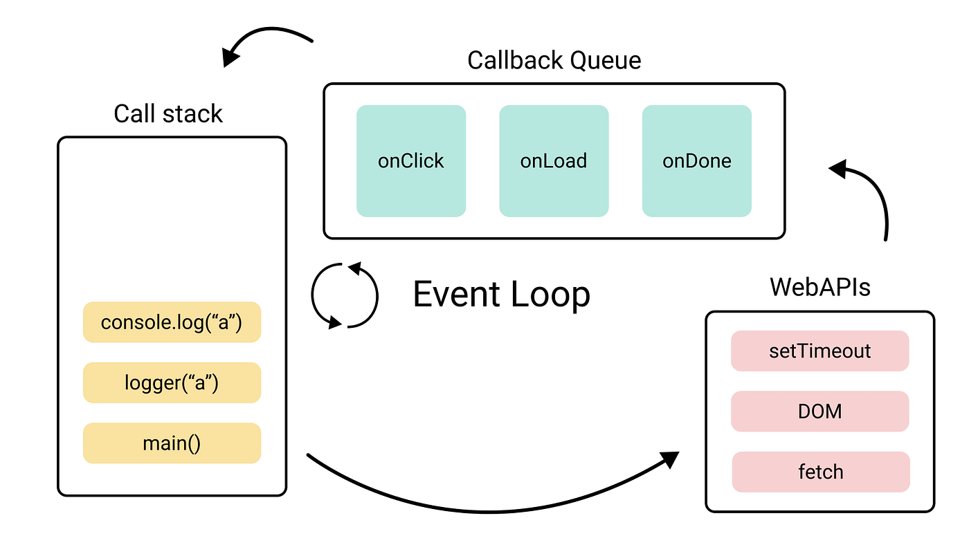
How does JS Engine make this happen?
One Event Loop means that we have single thread of execution
WebAPI are used for asynchronous tasks
Queues are used for “await”-ing tasks
When call stack gets empty, event loop picks up tasks from Callback Queue
Notes:
<read slide>.
- JS Engine includes a {single} call stack that keeps track of each function that it is being executed
- Asynchronous (heavy) tasks are outsourced to WebAPI. When those are completed, they are placed in a callback queue.
- Event loop picks up “awaiting” {completed} tasks from queue when call stack is empty (i.e., when it is done with everything it was working on – think run to completion) and processes them in the order they were added to queue (i.e., they were completed by WebAPI)

Slide 29
We achieve this goal using two techniques: 1. cooperative multiprocessing 2. non-blocking IO
But where does the non-blocking IO come from?
Notes:
That concludes our tour of cooperative multiprocessing.
But where does the non-blocking IO come from?

Slide 30
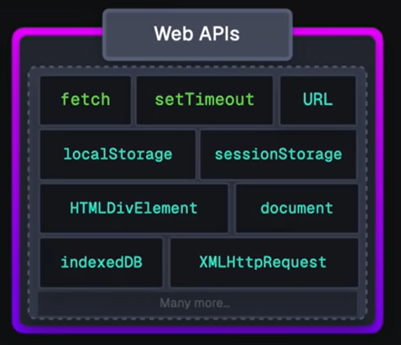
Answer: JS/TS has some primitives for starting a non-blocking computation
These are things like http requests, I/O operations, or timers.
Each of these returns a promise that you can await. The promise runs while it is pending, and produces the response from the http request, or the contents of the file, etc.
You will hardly ever call one of these primitives yourself; usually they are wrapped in a convenient procedure, e.g., we write
axios.get('https://rest-example.covey.town’)
to make an http request, or
fs.readFile(filename)
to read the contents of a file.
Notes:
This is what we said back on the slide with the stork, where we said "Some typescript libraries have API procedures that return promises"

Slide 31
Pattern for starting a concurrent computation using non-blocking I/O
export async function makeRequest(requestNumber:number) {
console.log(`starting makeRequest(${requestNumber})`);
const response = await axios.get('https://rest-example.covey.town');
console.log('request:', requestNumber, '\nresponse:', response.data);
}
The first console.log is printed
The http request is sent, using non-blocking i/o
A promise is created to run the second console.log after the axios.get returns
The makeRequest() returns to its caller.
Notes:
It is important to note that you can call makeRequest but it will be awaiting a future response. That promise was returned immediately back to the caller (whichever promise called the makeRequest) and that the caller’s thread continues on while makeRequest is waiting for a response, just as in our previous examples.

Slide 32
Pattern for starting a concurrent computation using non-blocking I/O
Maybe better?
export async function makeRequest(requestNumber:number) {
console.log(`starting makeRequest(${requestNumber})`);
const response = await axios.get('https://rest-example.covey.town');
console.log('request:', requestNumber, '\nresponse:', response.data);
}
The first console.log is printed
The http request is sent, using non-blocking i/o
The browser goes about its business
Eventually, the axios.get returns.
Some time after that, the console.log is printed and the makeRequest concludes.
Any promises that are waiting for the result of makeRequest become eligible for execution.
Notes:
It is important to note that you can call makeRequest but it will be awaiting a future response. That promise was returned immediately back to the caller (whichever promise called the makeRequest) and that the caller’s thread continues on while makeRequest is waiting for a response, just as in our previous examples.

Slide 33
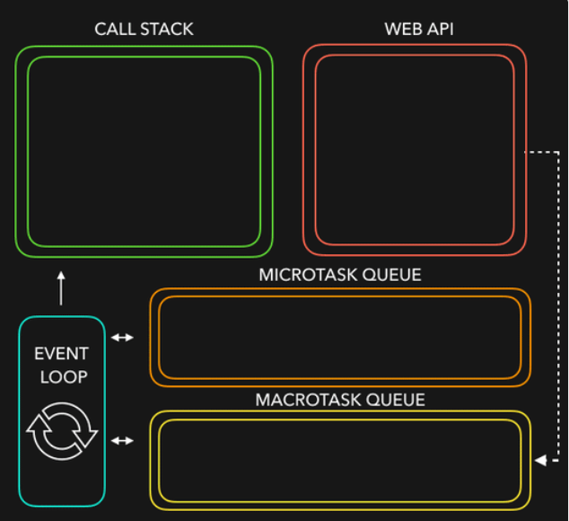
Let’s put it all together
JS/TS has single event loop
We outsource most of the non-blocking IO work (to WebAPIs) for asynchronous work
Upon completion, they are placed in queues (Microtask queue has priority over Macrotask queue)
Event loop picks them up from queue when call stack is empty!
Notes:
Javascript is a single threaded language. This means it has one call stack and one memory heap. It uses WebAPI to work asynchronously.
How do we get asynchronous code with Javascript then?
Well, we can thank the Javascript engine (V8, Spidermonkey, JavaScriptCore, etc...) for that, which has Web API that handle these tasks in the background. The call stack recognizes functions of the Web API and hands them off to be handled by the browser. Once those tasks are finished by the browser, they return and are pushed into a queue (callbacks go in Macrotask queue and promises go into microtask queue)
Then they are picked up by the event loop one by one and added onto the call stack.
Try this http://latentflip.com/loupe

Slide 34
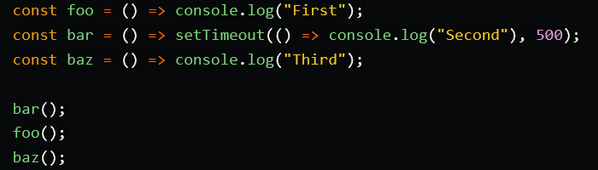
Here is a quick demo for you
Courtesy of https://dev.to/lydiahallie/javascript-visualized-event-loop-3dif
Notes:
Courtesy of https://dev.to/lydiahallie/javascript-visualized-event-loop-3dif

Slide 35
General Rules for Writing Asynchronous Code
You can’t return a value from a promise to an ordinary procedure.
You can only send the value to another promise that is awaiting it.
Call async procedures only from other async functions or from the top level.
Break up any long-running computation into async/await segments so other processes will have a chance to run.
Leverage concurrency when possible
Use promise.all if you need to wait for multiple promises to return.
Check for errors with try/catch

Slide 36
Odds and Ends You Should Know

Slide 37
Async/await code is compiled into promise/then code
async function makeThreeSerialRequests(){ 1. console.log('Making first request’); 2. await makeOneGetRequest(); 3. console.log('Making second request’); 4. await makeOneGetRequest(); 5. console.log('Making third request’); 6. await makeOneGetRequest(); 7. console.log('All done!'); } makeThreeSerialRequests();
console.log('Making first request'); makeOneGetRequest().then( () =>{ console.log('Making second request'); return makeOneGetRequest(); }).then(() => { console.log('Making third request'); return makeOneGetRequest(); }).then(()=>{ console.log('All done!'); });
Notes:
Promises

Slide 38
Promises Enforce Ordering Through “Then”
1. console.log('Making requests');
2. axios.get('https://rest-example.covey.town/')
.then((response) =>{
console.log('Heard back from server');
console.log(response.data);
});
3. axios.get('https://www.google.com/')
.then((response) =>{
console.log('Heard back from Google');
});
4. axios.get('https://www.facebook.com/')
.then((response) =>{
console.log('Heard back from Facebook');
});
5. console.log('Requests sent!');
axios.get returns a promise.
p.then mutates that promise so that the then block is not run until after the original promise returns.
The resulting promise isn’t completed until the then block finishes.
You can chain .then’s, to get things that look like p.then().then().then()
Each then is a pause point.
Notes:
Promises enforce the order of operations only through the .then. The code in the ‘then’ won’t run until the promise is resolved.
(build through example, explaining the possible orders of results. Point out that we should never depend on the order of results we hear back form google/facebook/coveytown because it is non-deterministic. You might happen to see 9/10 times one ordering, but there is no guarantee)

Slide 39
But you can still have a data race
src/data-races/dataRace.ts
let x : number = 10
async function asyncDouble() {
// start an asynchronous computation and wait for the result
await makeOneGetRequest(1);
x = x * 2 // statement 1
}
async function asyncIncrementTwice() {
// start an asynchronous computation and wait for the result
await makeOneGetRequest(2);
x = x + 1; // statement 2
x = x + 1; // statement 3
}
async function run() {
await Promise.all([asyncDouble(), asyncIncrementTwice()])
console.log(x)
}
Notes:
You can still have a data race with async await. Here's the same program we looked at before. Here the printed value of x depends on which of the two promises returns first: if asyncDouble returns first, then the result will be 22 (10*2 + 1 + 1). If asyncIncrementTwice returns first, then the result will be 24 (10+1+1)*2 . But 25 is impossible!

Slide 40
Review
You should now be prepared to:
Explain the difference between JS run-to-completion semantics and interrupt-based semantics.
Given a simple program using async/await, work out the order in which the statements in the program will run.
Write simple programs that create and manage promises using async/await
Write simple programs to mask latency with concurrency by using non-blocking IO and Promise.all in TypeScript.
Notes:
<read slide>

